Slide 1








HR DATA ANALYTICS
Driving Performance & Engagement
PRESENTATION - 2025
Prepared By:
Shamal Vidhate
linkdin link
https://www.linkedin.com/in/shamal-vidhate

Slide 2




PAGE 1
Introduction :
In today's data-driven world, HR Data Analytics plays a crucial role in improving workforce management and decision-making. By leveraging SQL (Structured Query Language), HR professionals can extract, analyze, and visualize key HR metrics efficiently.
Objective :
✅ Understand the Role of SQL in HR Analytics .
✅ Explore Key HR Metrics & Use Cases .
✅ Learn Basic SQL Queries for HR Insights
✅ Enhance Data

Slide 3




PAGE 2
Scope of Work
1️⃣ Workforce & Employee Insights
2️⃣ Recruitment & Hiring Analysis
3️⃣ Employee Performance & Productivity
4️⃣ Compensation & Payroll Analysis
5️⃣ Employee Engagement & Satisfaction
6️⃣ Diversity & Inclusion Metrics
7️⃣ Compliance & HR Policy Monitoring
8️⃣ Predictive & Strategic HR Analytics

Slide 4
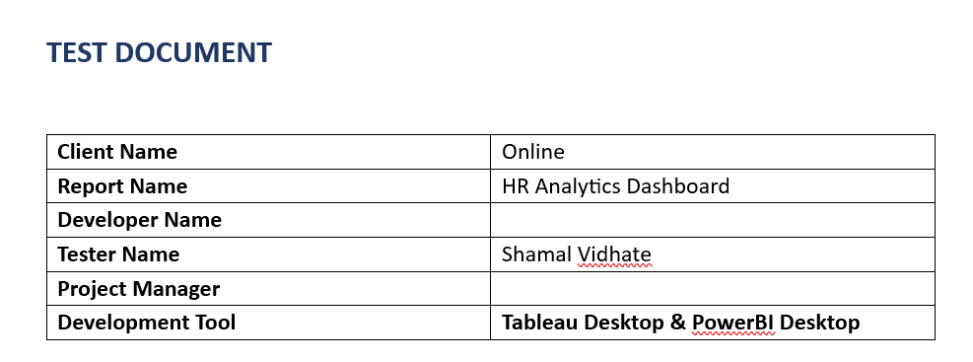
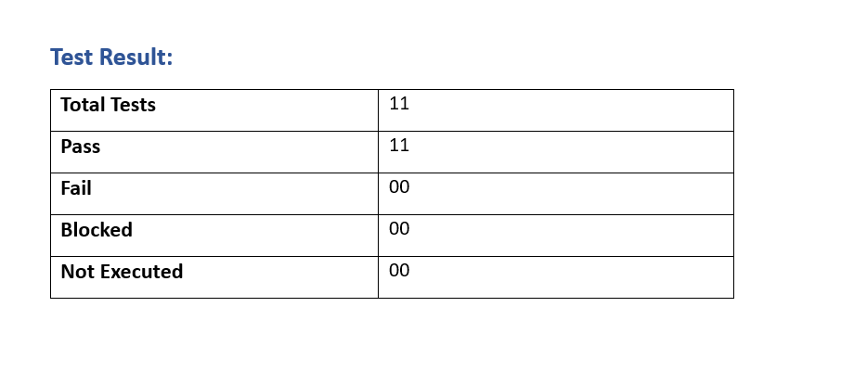
PAGE 3
Test Document :

Slide 5
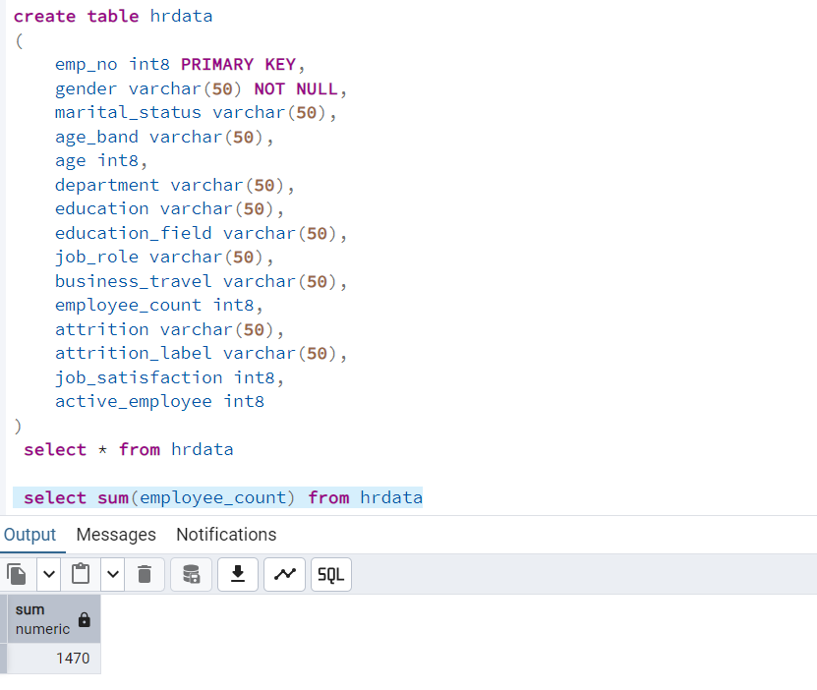
PAGE 4
DATA ANALYST PORTFOLIO SQL PROJECT
Import Data in Table Using Query
Employee Count:

Slide 6
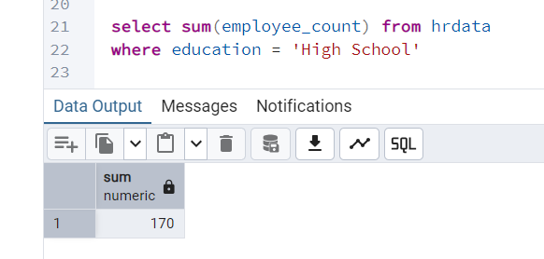
PAGE 5
Employee Count:

Slide 7
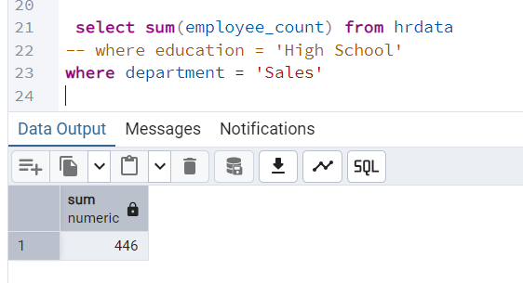
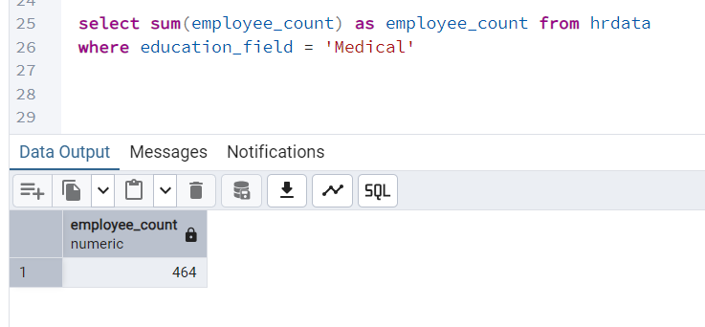
PAGE 6
Employee Count: by condition

Slide 8
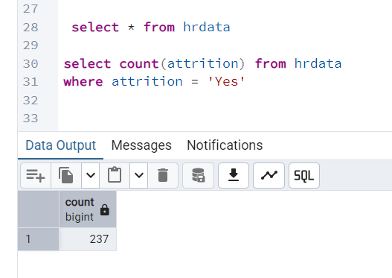
PAGE 7
Attrition Count:

Slide 9
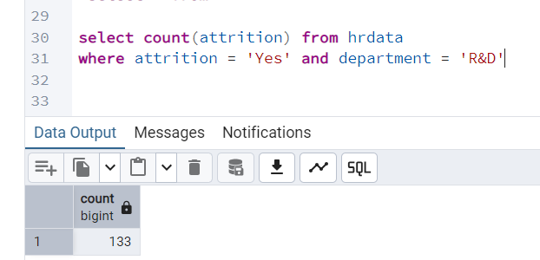
PAGE 8
Attrition Count: By Condition

Slide 10
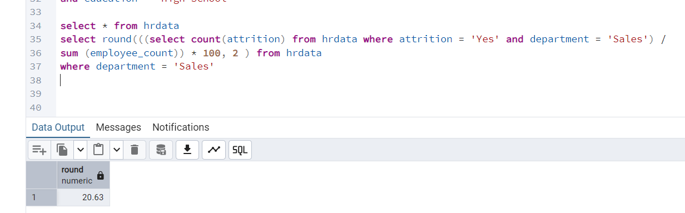
PAGE 9
Attrition Rate:

Slide 11
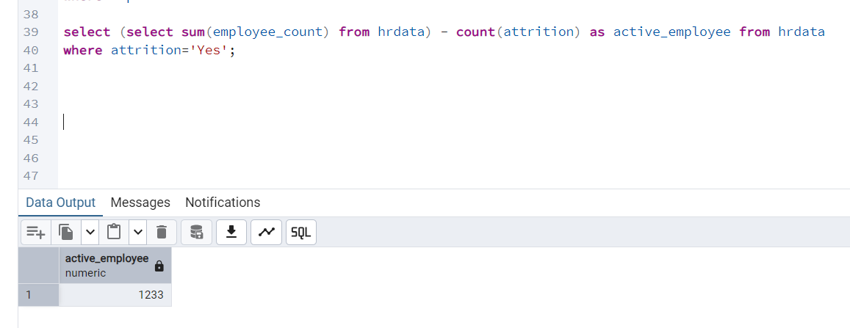
PAGE 10
Active Employee:

Slide 12
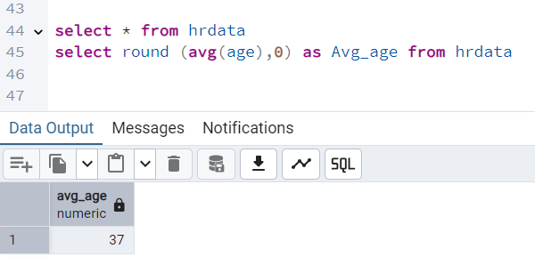
PAGE 11
Average Age:

Slide 13
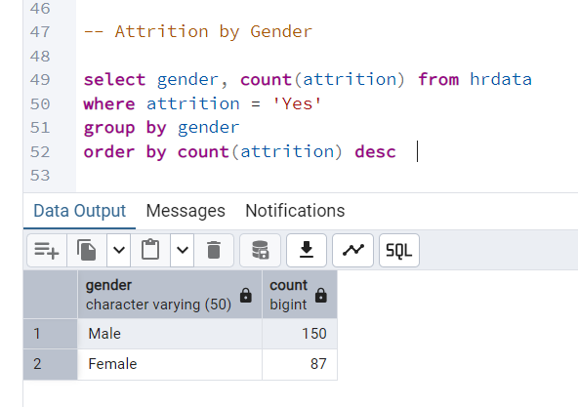
PAGE 12
Attrition by Gender:

Slide 14
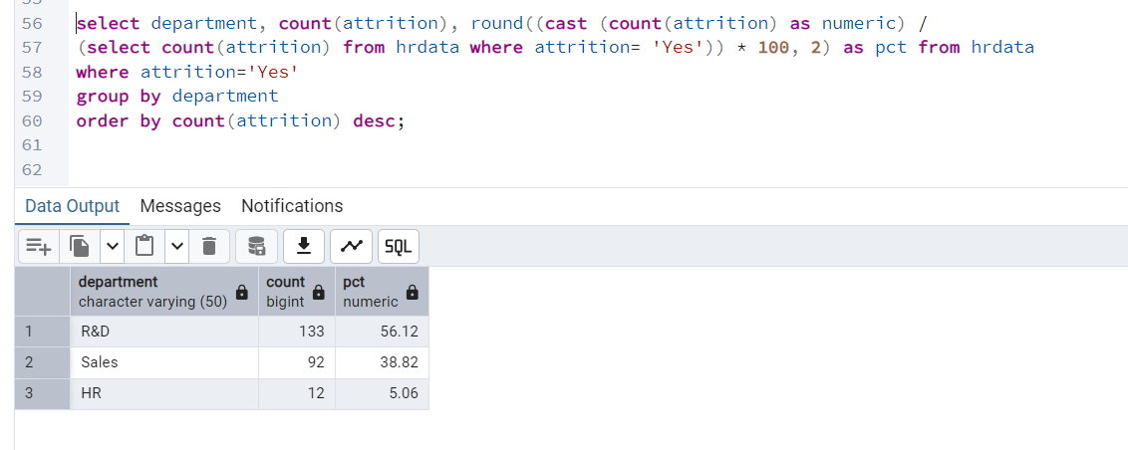
PAGE 13
Department wise Attrition:

Slide 15
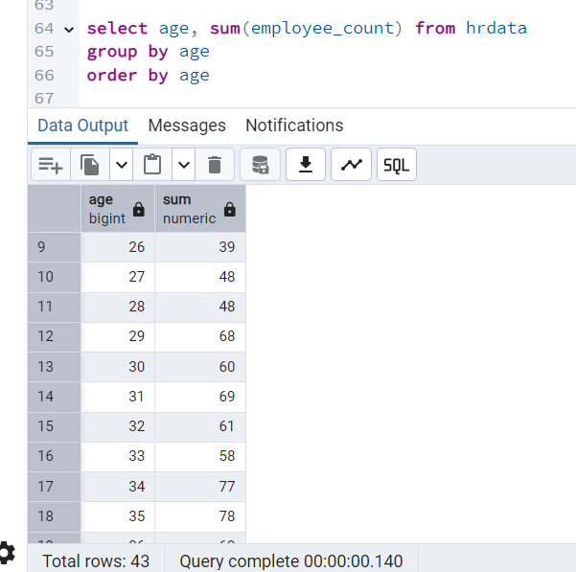
PAGE 14
No of Employee by Age Group:

Slide 16
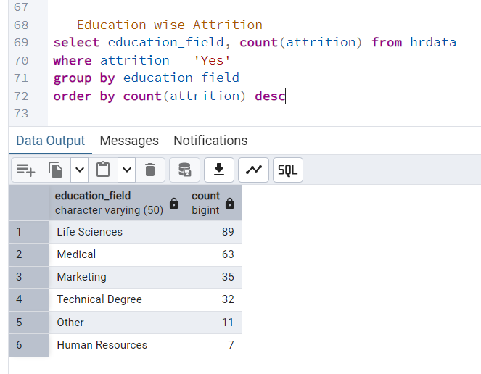
PAGE 15
Education Field wise Attrition:

Slide 17
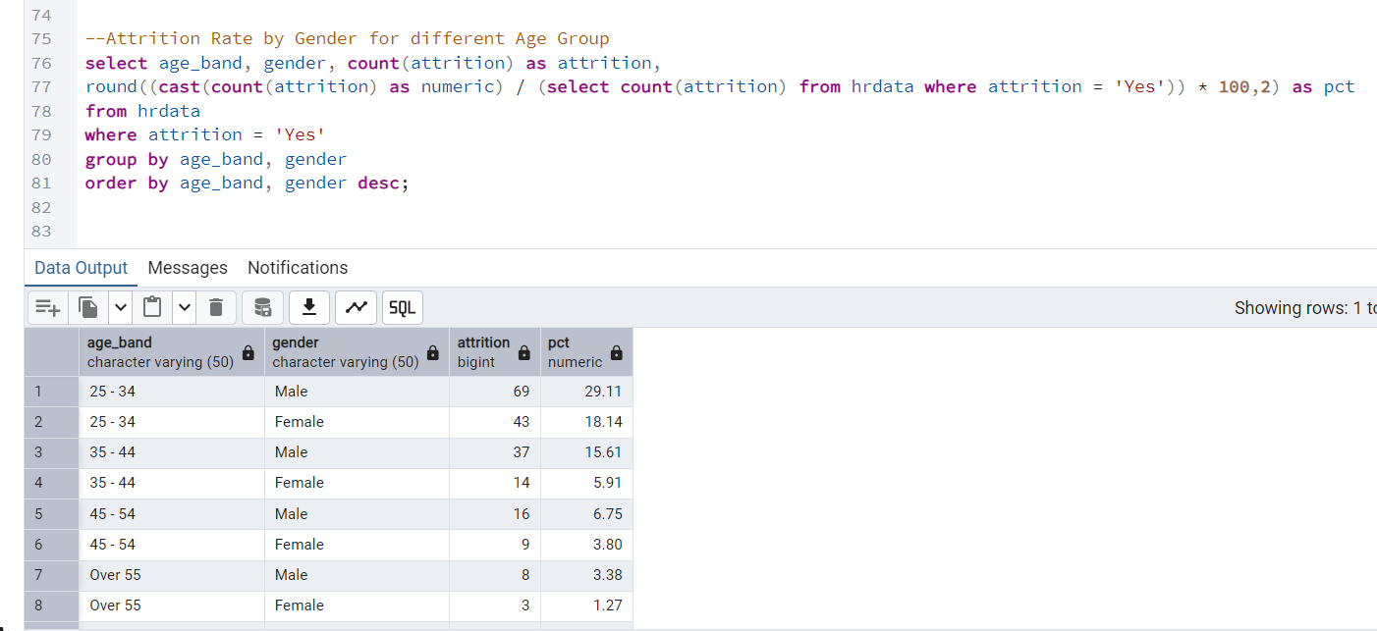
PAGE 16
Attrition Rate by Gender for different Age Group :

Slide 18
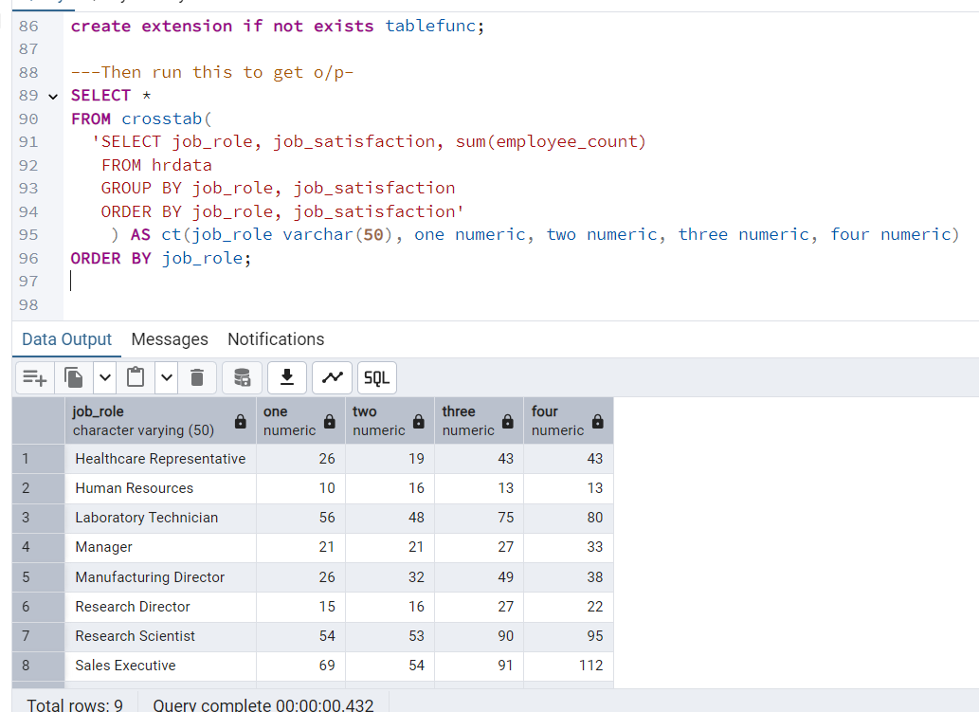
PAGE 17
Job Satisfaction Rating :

Slide 19




THANK YOU
For Attending Our Presentation
PRESENTATION - 2025
Contact Us For More Information
9130747955
vidhateshamal2000@gmail.com
https://www.linkedin.com/in/shamal-vidhate

